Slide 1
Lecture 7: Convolutional Neural Networks (CNNs)
QMUL Machine Learning society
Manuel Teres

Slide 2
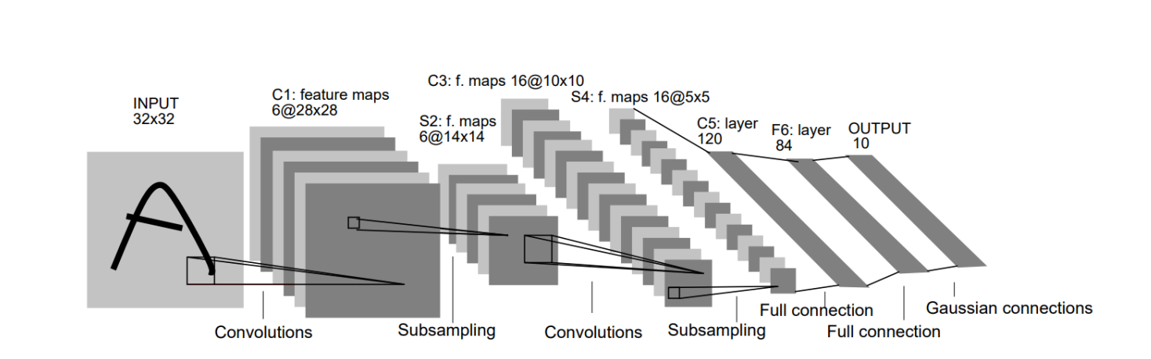
Introduction to CNNs
Definition: CNNs are a class of deep neural networks designed for image processing.
Key applications: Image recognition, object detection, medical imaging, etc.
Structure: Consists of convolutional layers, pooling layers, fully connected layers.

Slide 3
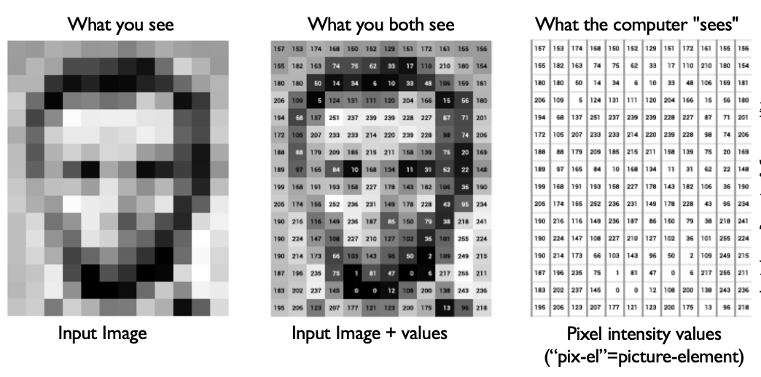
How do we feed data into the model

Slide 4
Convolutional Layers
Purpose: Extracts spatial features from input images.
Convolution operation:
Uses a kernel (filter) to slide over the image.
Computes dot product at each position.
Produces feature maps.
Example:
3x3 filter applied to a 5x5 image.
Activation function: ReLU (Rectified Linear Unit) for non-linearity.
We usually add padding

Slide 5
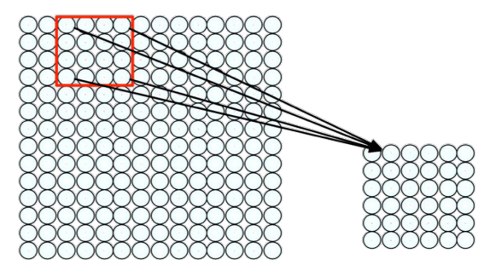
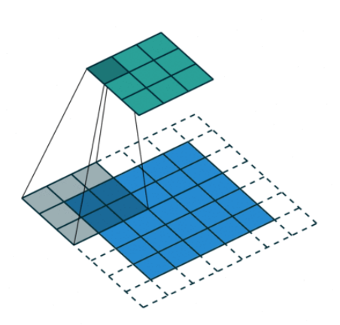
Kernel (filter) sliding over the image

Slide 6
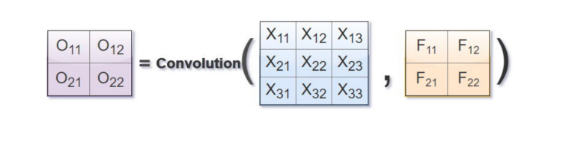
Resulting Matrix after applying the filter
Resulting Matrix = Convolution(Initial Data, Filter)

Slide 7
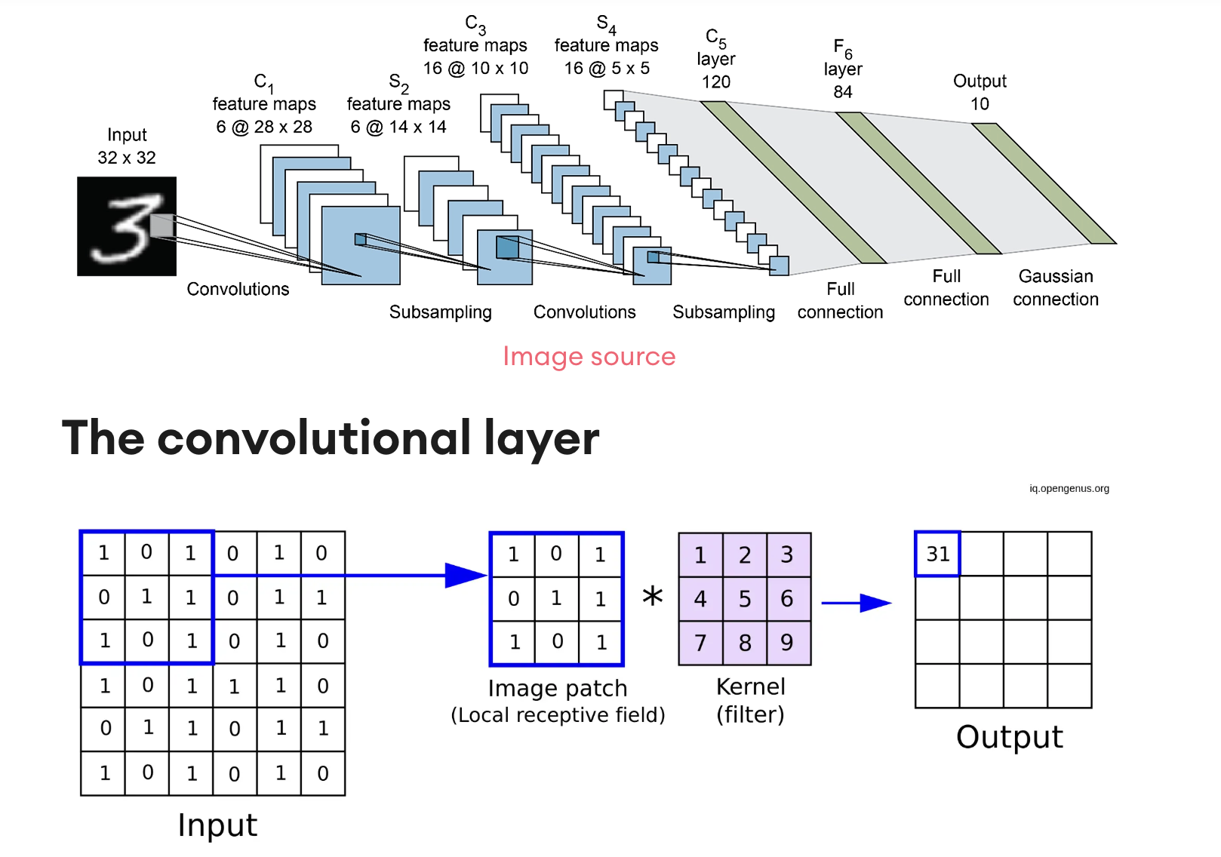
Practical Numerical Example

Slide 8
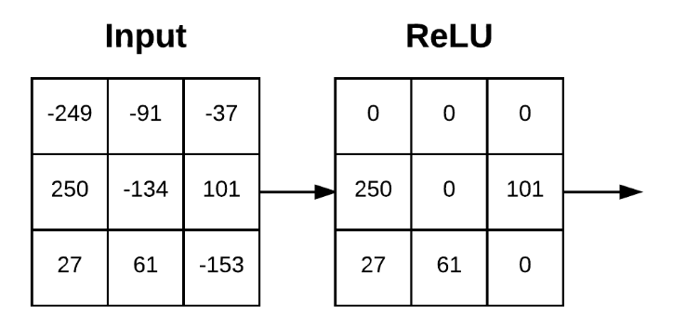
Use of an activation function to introduce non-linearity
Recall that ReLU makes negative inputs = 0.

Slide 9
Stride and Padding
Stride: Defines the step size of the filter.
Larger stride reduces spatial dimensions.
“How many steps does it take the filter to go through the image”
Padding:
Zero-padding preserves spatial dimensions.
Used to avoid excessive size reduction.
Example: 5x5 input with a 3x3 filter and stride 2.

Slide 10
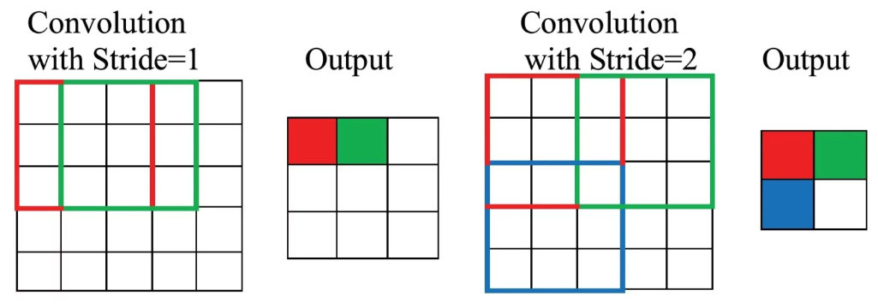
Stride

Slide 11
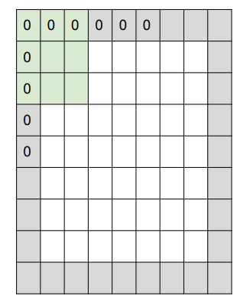
Padding
It is common to add 0s to the edges of the images. Otherwise, we are downsampling the image and losing

Slide 13
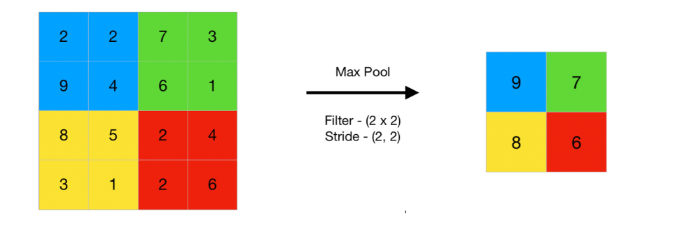
Pooling Layers
Purpose: Reduces spatial dimensions while retaining important features.
Types:
Max pooling: Takes the maximum value from a region.
Average pooling: Takes the average value.
Benefit: Reduces overfitting and computation cost.

Slide 14
Grayscale vs Colour Images
Grey Scale:
Single-channel (1D) input.
Faster computation, less data.
Colour (RGB):
3-channel (Red, Green, Blue) input.
More complex feature extraction.
MNIST data set: 28x28 grayscale image vs. 28x28x3 RGB image.

Slide 15
Colour RGB: 3-channel (Red, Green, Blue) input

Slide 16
Data Augmentation
​​Purpose: Increases dataset diversity to improve generalisation.
Techniques:
Rotation, flipping, zooming, brightness adjustment.
Random cropping and noise addition.
Example: Original vs. augmented images.
Benefit: Reduces overfitting and improves model robustness.

Slide 17
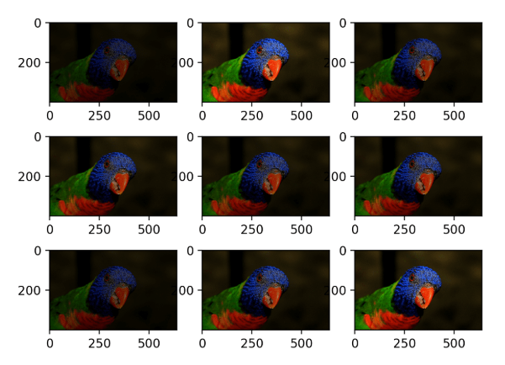
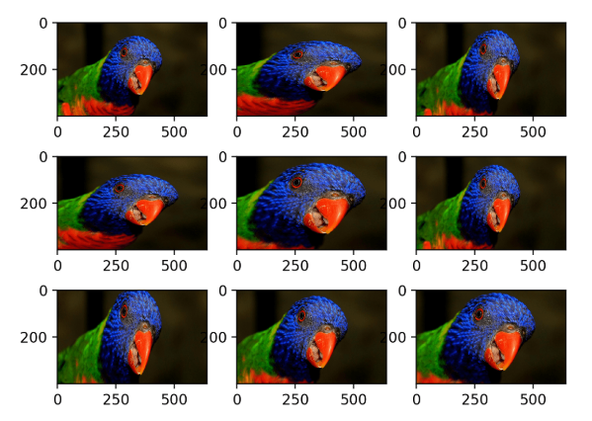
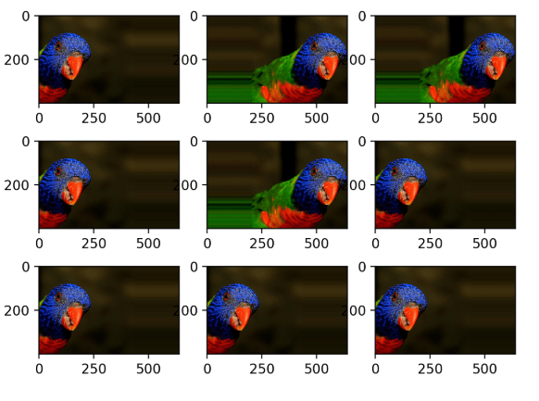
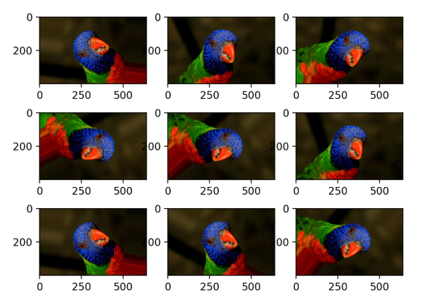

Slide 18
Training Parameters in CNNs
Forward Pass:
Input data (images) is passed through the network.
Each layer performs operations (convolution, activation, pooling).
Outputs are generated for each layer.
Loss Calculation:
A loss function computes the error between predicted output and true labels.
The goal is to minimise this loss through training.

Slide 19
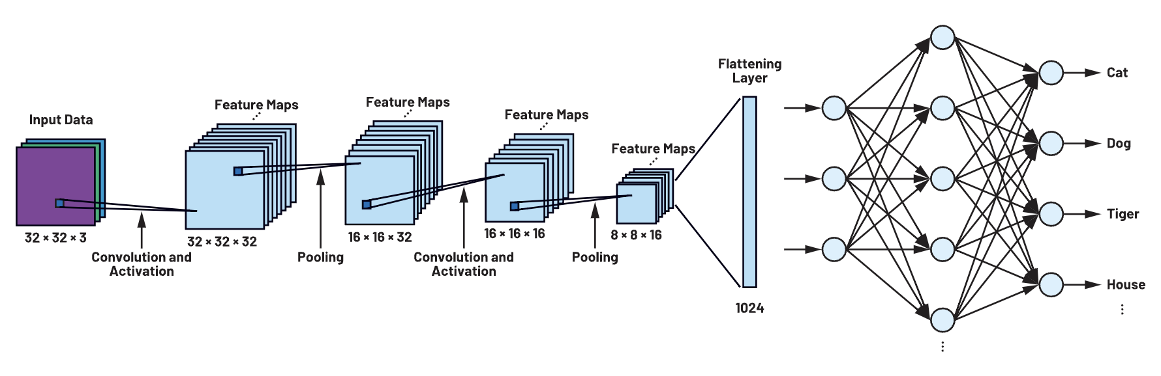
Backward Pass:
Backpropagation calculates gradients of the loss with respect to the network parameters.
Gradients indicate how to adjust the parameters (weights and biases) to reduce the error.
Optimizer:
Optimisers like SGD or Adam adjust the parameters based on the gradients.

Slide 20
Parameters Trained in Convolutional Neural Networks (CNNs)
Weights:
The weights are the kernels (filters) applied to input data.
Biases:
Bias terms added to the output of the convolution before activation.
Fully Connected Layer Parameters:
Weights and biases of the fully connected (dense) layers at the end of the network.

Slide 21
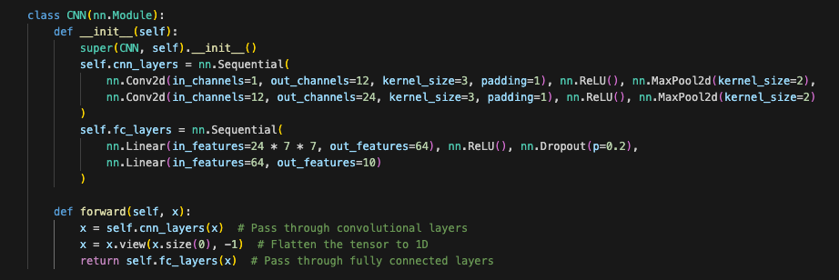
Pytorch Implementation

